Slide 1









INSOMINA EARSER
GRAUDATION PROJECT

Slide 2



SUPERVISED BY :
PROF/ AMIRA
ENG/ NORHAN KHASHABA
TEAM
1 - ANAS MAHMOUD MOHAMED (20-00668)
2 - MOSTAFA MOHAMED SHAWKY GAD (20-01693)
3 - ABDALLAH SALAH ABDELKAREEM (20-00539)
4 - ADHAM ALLA ABDELAZZEEM (20-01203)
5 - MARCO MILAD MANKARUIOS (20-00023)
6 - MARWAN HESHAM ABDELMONEM (20-01319)

Slide 3
OUTLINE
Introduction
Problem Statement
Objectives (Solutions)
Requirement Analysis
Diagrams
Mobile Application
Proposed model
Dataset
Conlusion
Reference
Future Work

Slide 4





Introduction
Sleep is a critical aspect of human health, allowing the body and mind to rest, repair, and rejuvenate. However, millions of people worldwide struggle with sleep insomnia, a condition characterized by difficulty falling asleep, stayingasleep, or both. Insomnia can have a significant impact on overall well-being, leading to daytime fatigue,
irritability, impaired cognitive function,and an increased risk of chronic healthconditions.

Slide 5
The causes of sleep insomnia are complex and multifaceted, ranging
from stress andanxiety to medical conditions and environmental
factors. Addressing insomnia oftenrequires a multi-faceted approach,
including lifestyle modifications, cognitive- behavioural therapy, and,
in some cases, medication. With proper diagnosis,
treatment, and self-care strategies, individuals with insomnia can
improve their sleepquality and overall health

Slide 6



REQUIREMENT ANALYSIS
1. Interviews: Conduct one-on-one or group interviews with potential users,
sleep experts, psychologists, healthcare professionals, and other stakeholders.
Ask open-ended questions to gather insights into their sleep patterns,
challenges, preferences, and expectations from the application.
2. Surveys and Questionnaires: Design and distribute surveys or
questionnaires to a wide audience to collect quantitative and qualitative data
on sleep habits, preferences, and desired features. Analyse the responses to
identify common patterns and requirements.
3. Focus Groups: Organize interactive group discussions with a diverse set
of stakeholders to encourage brainstorming, idea sharing, and gathering
different perspectives on the desired features and functionalities of the
insomnia application.

Slide 7
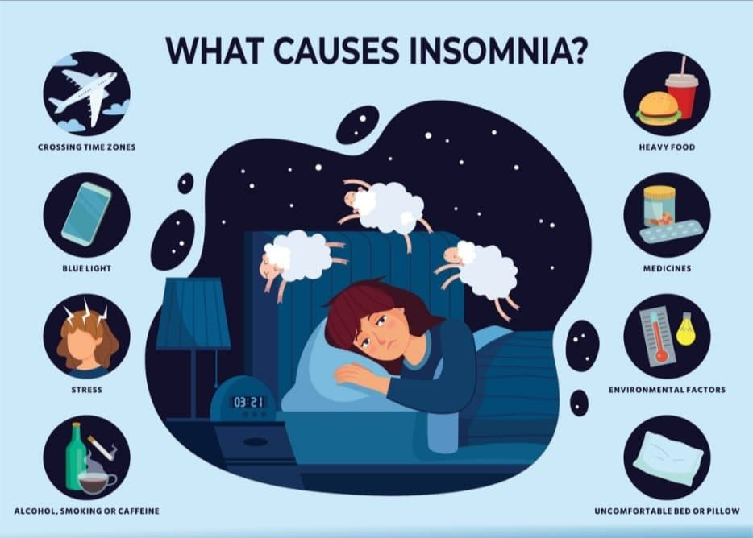

Slide 8



PROBLEM STATEMENT
In this project, we will discuss in detail a solution to
a very large contemporary problem of insomnia.
Insomnia is a common sleep disorder that can make
it hard to fall asleep, hard to stay asleep, or cause
you to wake up too early and not be able to get back
to sleep. You may still feel tired when you wake up.
Insomnia can sap not only your energy level and
mood but also your health, work performance and
quality of life. We target the people of all age who
suffer from insomnia, and the causes of
this disease varied from one person to another, and
according to the age group, some of them suffer due
to exposure to a psychological condition, trauma or
stresses in life, travel and Poor sleep habits

Slide 9

we try to treat them in the best and simplest way through several different. We will providethe patient with some importantinformation about
thedisease, help him discover it, and help treat it by communicating with the doctorat any time in the case of chronic disease. - If he has some other sub-problems, such as excessive thinking, anxiety, or drinking stimulants, we will provide him with his ownlibrary that contains everything he needs to get rid of these problems, as it contains a special health regimen for him (exercise, food), or listening to the Qur’an to get rid of thinking, or music calm and helps him sleep, with some medical and scientific advicefor all that.

Slide 10
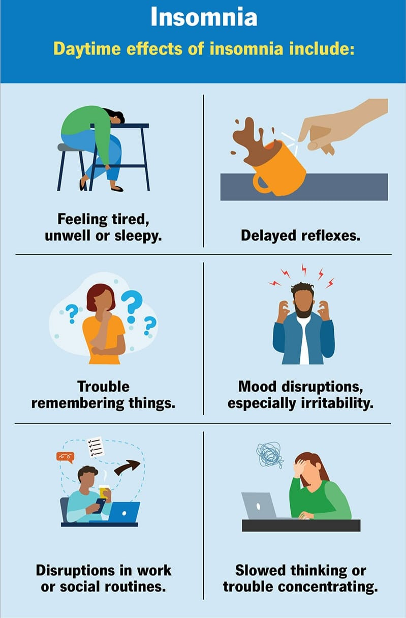

Slide 11


SOLUTION
Treating sleep disorders is crucial to society as it contributes to enhancing individuals’ overall health and psychological well-being Improving sleep quality can increase productivity at work, mitigate negative effects on daily performance, and address anxiety prevalent in society. Furthermore, focusing on treating sleep problems helps reduce the overall burden on
public health and health care costs, ultimately benefiting society as a whole,

Slide 12
project aims to:
1- Help patients identify and overcome insomnia through many mean
2- Make it easier for patients to find doctors.
3- Facilitate booking and managing appointments, as the patient can book at
any time convenient for him, which saves him time. through text or voice messages or chat through the application, which helps
4- Improve communication that patients and doctors can Communicate better in exchanging information faster and easier.
5- Providing various medical programs that help
change the patient’s lifestyle.

Slide 13
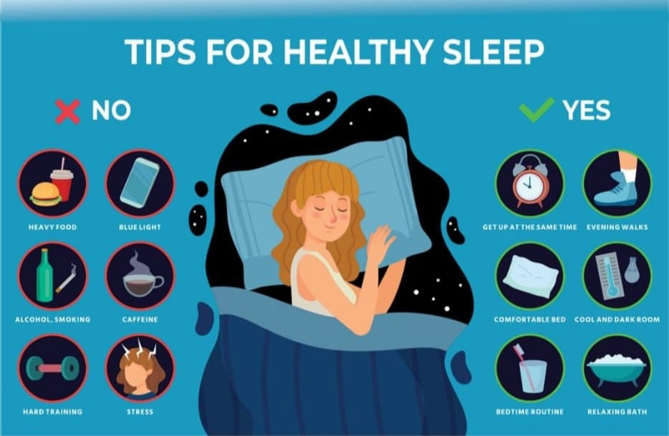

Slide 14
Patient functional requirement :-
•The system allows patient login by using basic information about him, like as name, age, email, governorate and Marital status.
•The system allows to all patient to make a record which contains all the previous history of him. at any time, patient can download this record.
•The system allow patient to decide with the doctor whether he works with him online or offline.
•The system allow patient to decide with the doctor whether he will communicate with him by chat or voice record

Slide 15
The system allows to patient to pay by many method (credit, cash, Fawry).
•The patient is the one who will choose the doctor who will communicate with him from among the group of doctors of the system he has nominated.
•Each patient in the system has a degree of progress in the treatment and this appear on his account.
•After finishing the consultations, the system allows the patient to make feedback to provide the impression about the doctor and his / her ways of treatments
•The system allow patient to make rate for the doctor and this rate is update.

Slide 16
Doctor functional requirement:
•The system allows the doctor to make a personal profile and upload His cv and certification.
•Doctor use the record of patient to make first impression about patient’s problem.
•doctor give the patient instructions about his medicine.
•The system allow doctor to decide what the patient need in his treatment, lonely session or with group.
•If the doctor is not available, the doctor asks the system to make him offline.

Slide 17
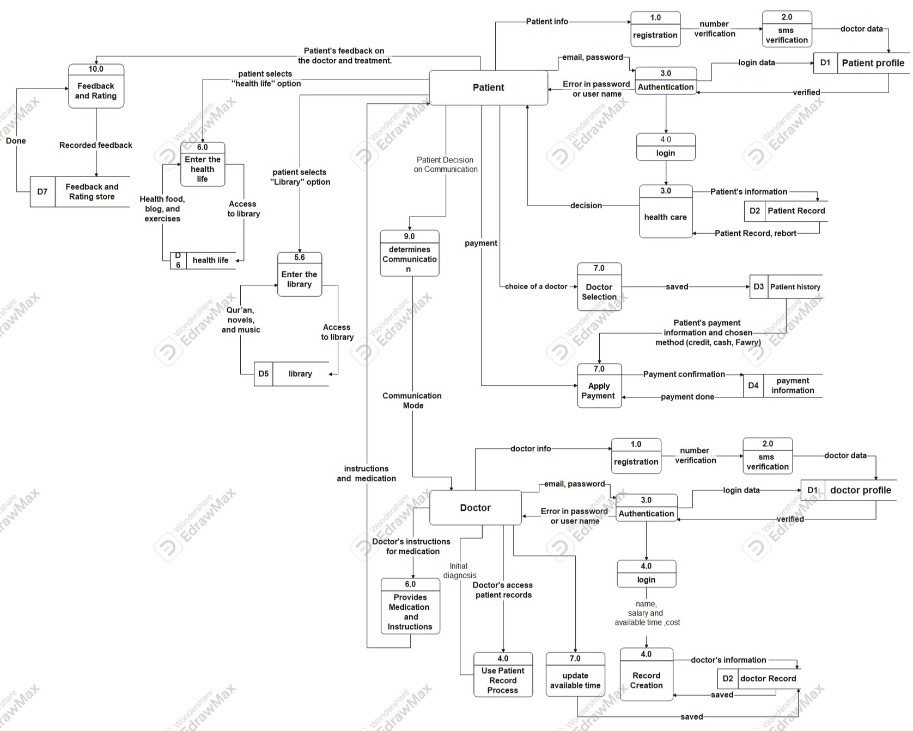
4.3 Data flow diagram

Slide 18
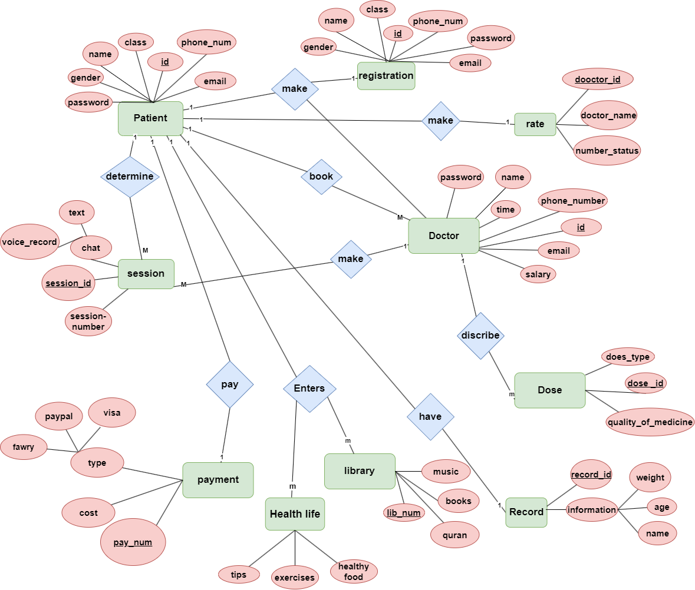
4.4 Entity relationship diagram

Slide 19
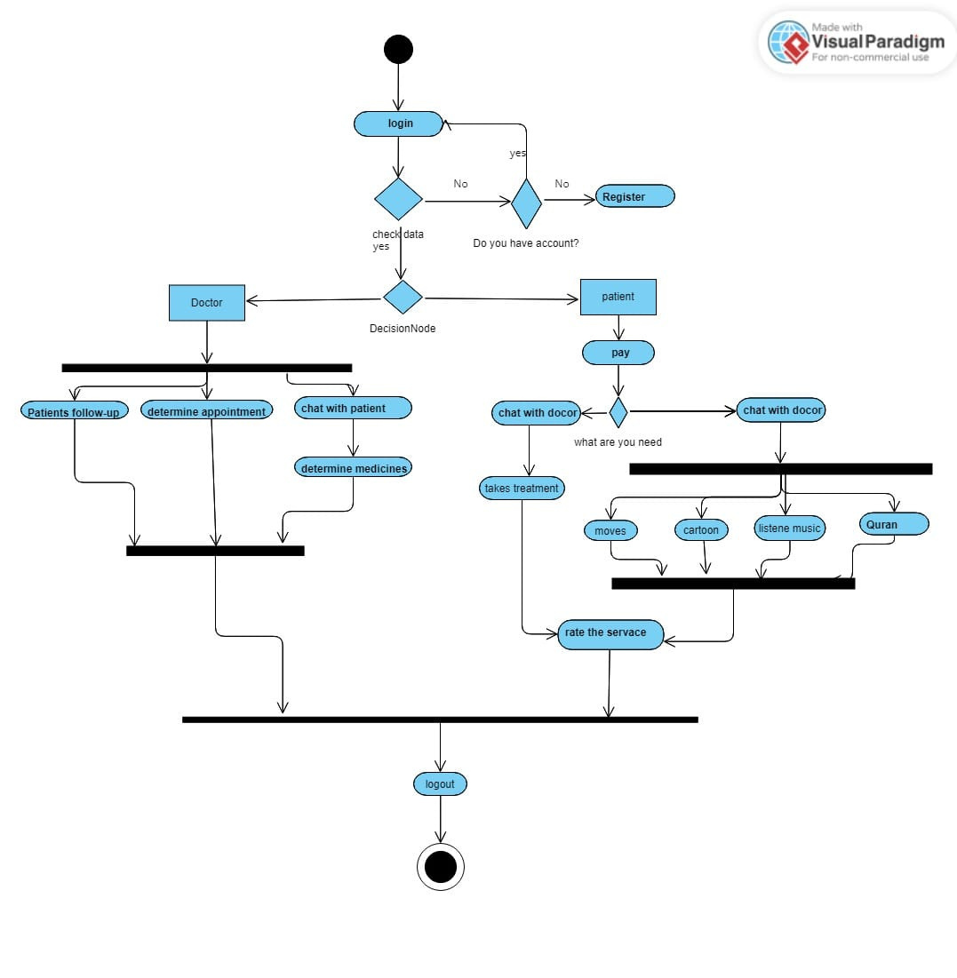
4.6 UML Activity diagram

Slide 20
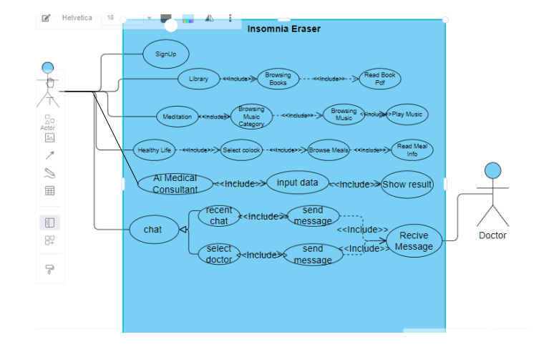
4.5 UML use case diagram

Slide 21
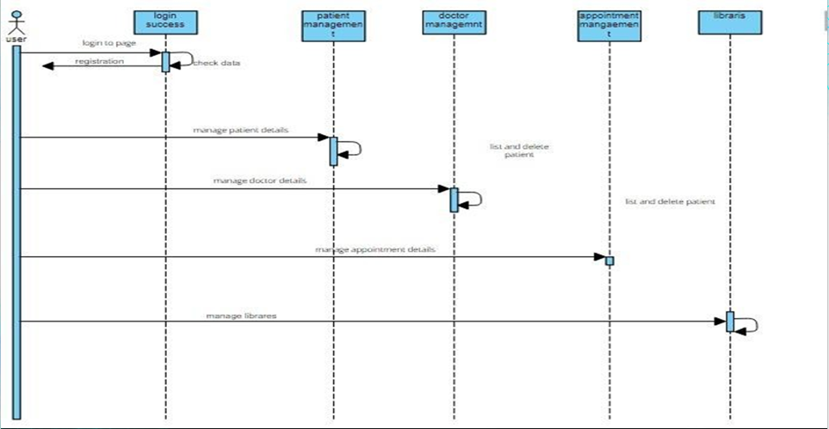
4.7 UML Sequence diagram

Slide 22




APPLICATION

Slide 23
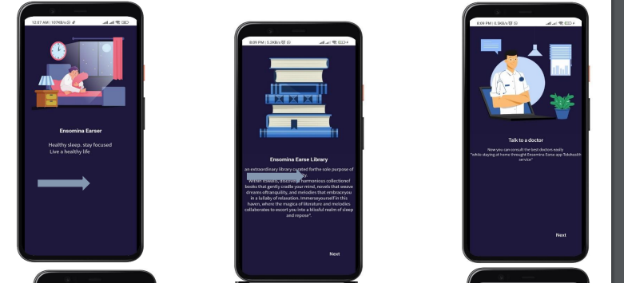

Slide 24
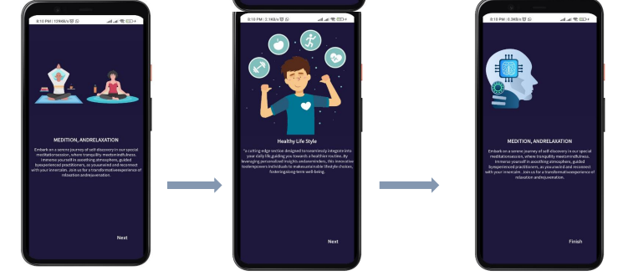

Slide 25
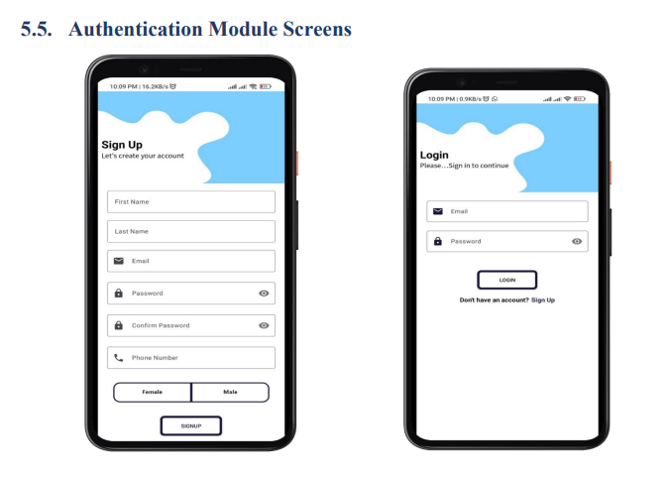

Slide 26
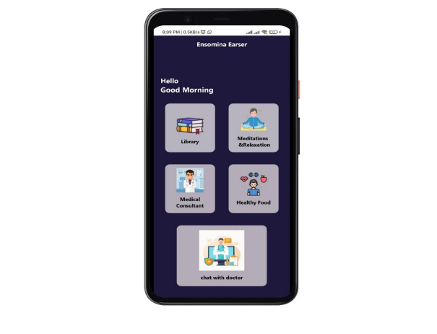

Slide 27
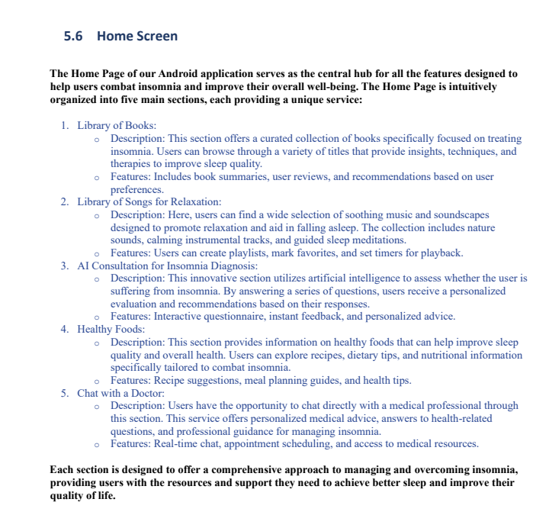

Slide 28
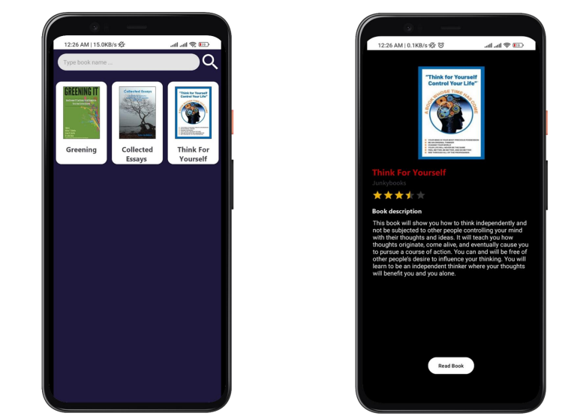

Slide 29
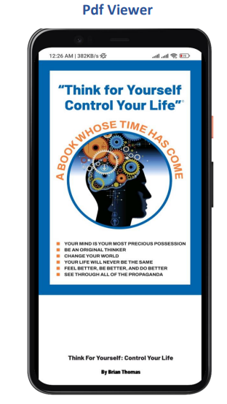

Slide 30
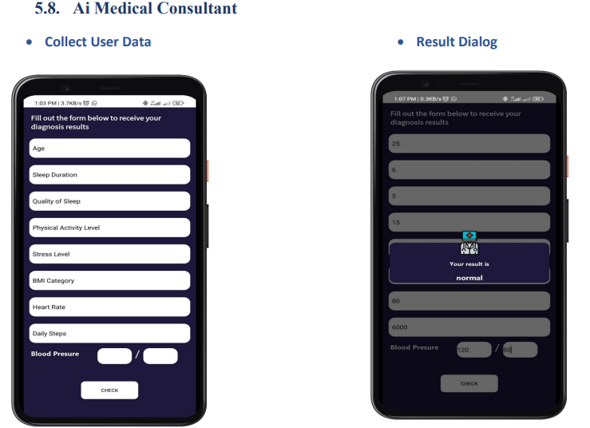

Slide 31
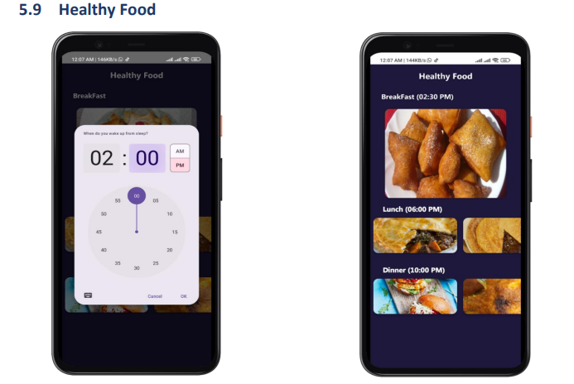

Slide 32
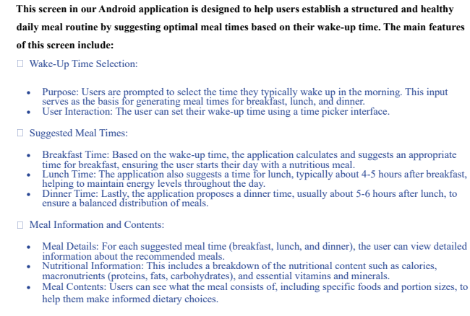

Slide 33
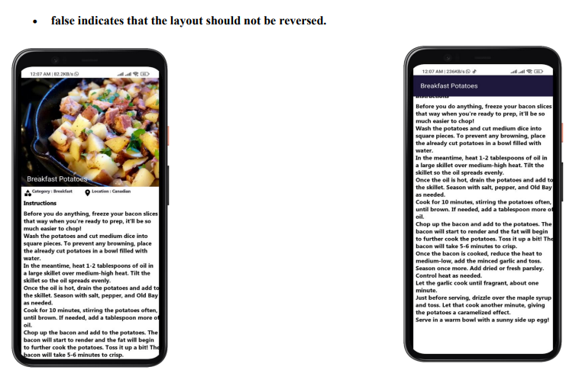

Slide 34
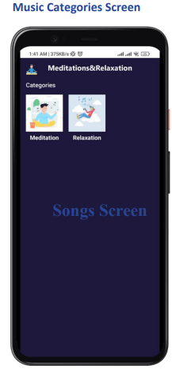

Slide 35
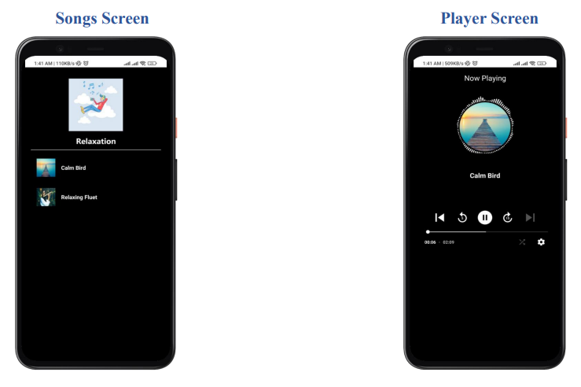

Slide 36
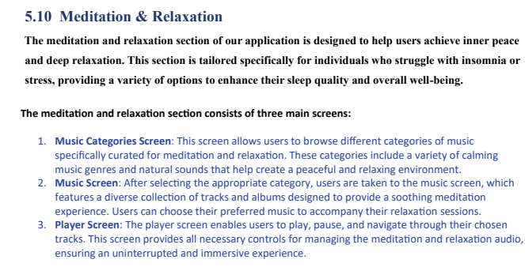

Slide 37
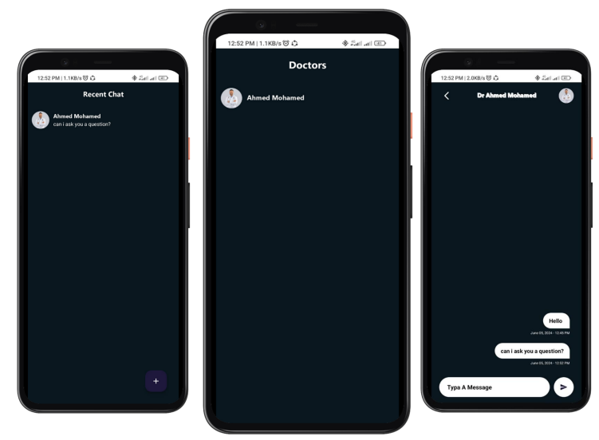

Slide 38
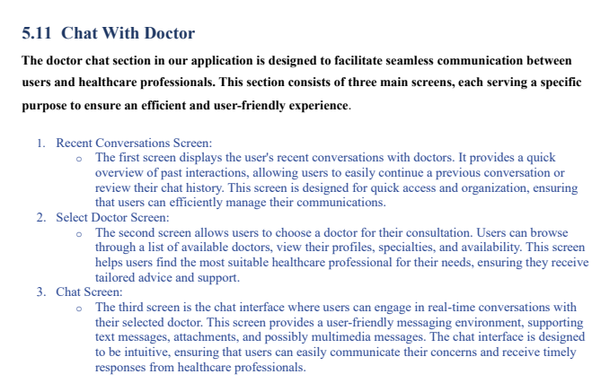

Slide 39
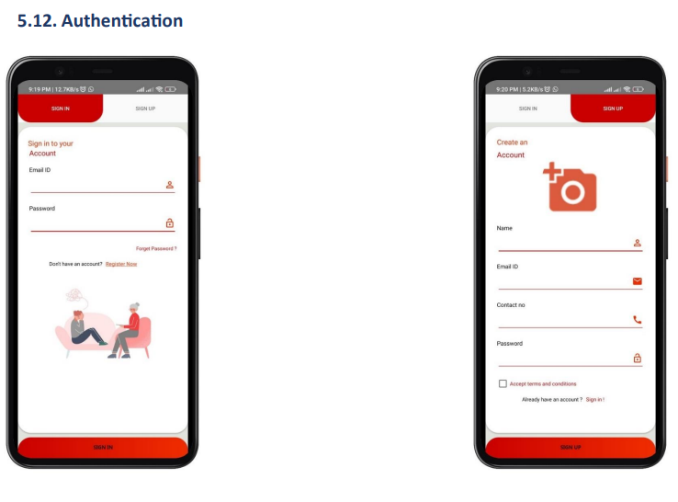

Slide 40
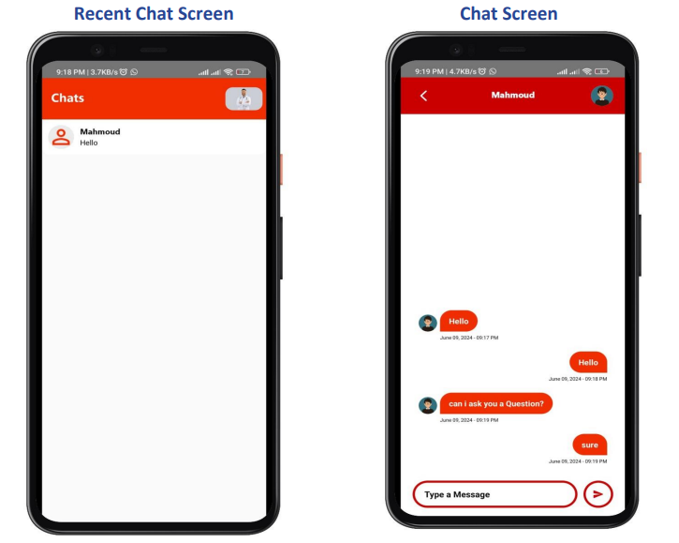

Slide 41
pROPOSED MODEL

Slide 42
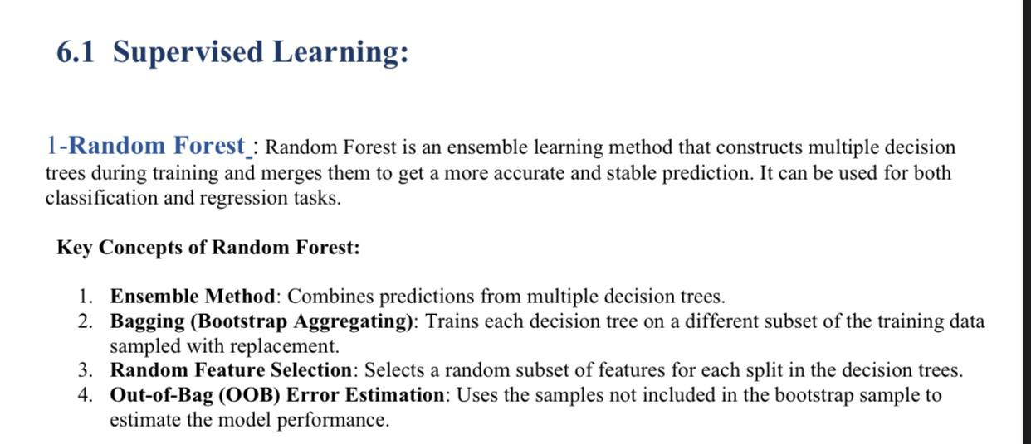

Slide 44
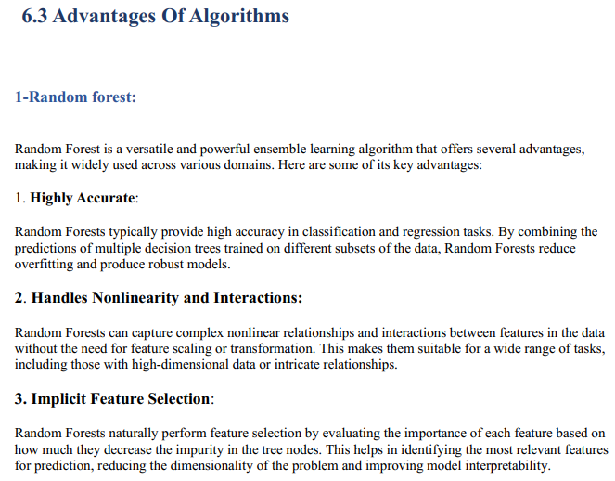

Slide 45
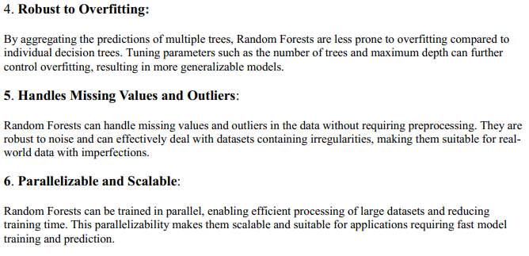

Slide 46
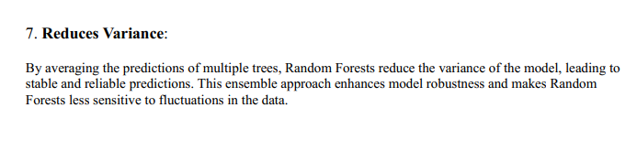

Slide 47
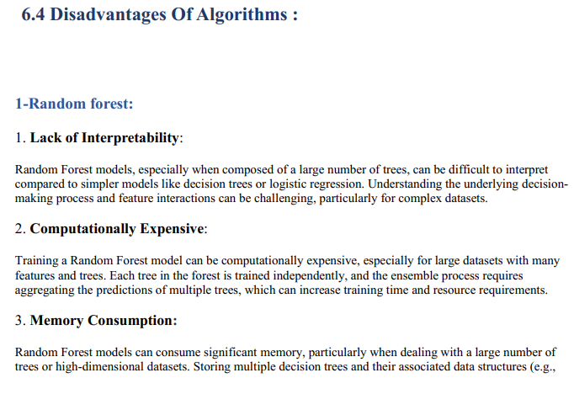

Slide 48
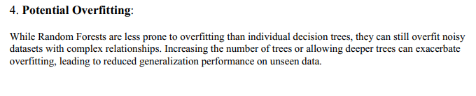

Slide 49
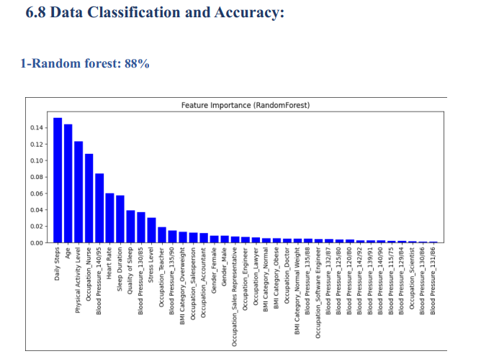

Slide 50
DATASET

Slide 51
Dataset Overview:
The Sleep Health and Lifestyle Dataset comprises 400 rows and 13 columns, covering a wide range of variables related to sleep and daily habits. It includes details such as gender, age, occupation, sleep duration, quality of sleep, physical activity level, stress levels, BMI category, blood pressure, heart rate, daily steps, and the presence or absence of sleep disorders.
Key Features of the Dataset:
Comprehensive Sleep Metrics: Explore sleep duration, quality, and factors influencing sleep patterns.
Lifestyle Factors: Analyze physical activity levels, stress levels, and BMI categories.
Cardiovascular Health: Examine blood pressure and heart rate measurements.
Sleep Disorder Analysis: Identify the occurrence of sleep disorders such as Insomnia and Sleep Apnea.

Slide 52
Dataset Columns:
Person ID: An identifier for each individual.
Gender: The gender of the person (Male/Female).
Age: The age of the person in years.
Occupation: The occupation or profession of the person.
Sleep Duration (hours): The number of hours the person sleeps per day.
Quality of Sleep (scale: 1-10): A subjective rating of the quality of sleep, ranging from 1 to 10.
Physical Activity Level (minutes/day): The number of minutes the person engages in physical activity daily.
Stress Level (scale: 1-10): A subjective rating of the stress level experienced by the person, ranging from 1 to 10.
BMI Category: The BMI category of the person (e.g., Underweight, Normal, Overweight).
Blood Pressure (systolic/diastolic): The blood pressure measurement of the person, indicated as systolic pressure over diastolic pressure.
Heart Rate (bpm): The resting heart rate of the person in beats per minute.
Daily Steps: The number of steps the person takes per day.
Sleep Disorder: The presence or absence of a sleep disorder in the person (None, Insomnia, Sleep Apnea).

Slide 53
Details about Sleep Disorder Column:
None: The individual does not exhibit any specific sleep disorder.
Insomnia: The individual experiences difficulty falling asleep or staying asleep, leading to inadequate or poor-quality sleep.
Sleep Apnea: The individual suffers from pauses in breathing during sleep, resulting in disrupted sleep patterns and potential health risks.
Acknowledgement:
I would like to clarify that the data I am presenting is synthetic and created by me for illustrative purposes.

Slide 54
Conclusion

Slide 55
This project culminates in the development of an application designed to assist individuals suffering from insomnia by offering a variety of services. Our primary objectives were successfully achieved:
1. *Multifaceted Support*: We have created an application that allows users to initiate discussions with multiple doctors, facilitating access to medical consultations through a novel artificial intelligence experience.
2. *Enhanced Doctor Accessibility*: The app streamlines the process of finding doctors and scheduling appointments, empowering users to book appointments conveniently via text, voice messages, or chat, saving them valuable time.
3. *Improved Communication*: By improving communication channels, patients and doctors can exchange information more efficiently, enhancing overall healthcare interactions.

Slide 56
4. *Diverse Medical Programs*: We introduced various medical programs aimed at fostering lifestyle changes among patients, thereby promoting better health outcomes.
5. *Future Development*: Looking forward, we aim to further enhance and expand the services offered within the application to better meet the needs of our users in the near future.
Throughout this project, we overcame several challenges, including sourcing free content such as books and music for the services provided, and implementing innovative uses of artificial intelligence to improve the user experience and effectively address insomnia-related issues.
In essence, this project represents a successful initiative in providing innovative solutions to insomnia, and we hope it contributes to improving the quality of life for those affected by this condition in the future.

Slide 57
Reference

Slide 58
1. *Books:*
- *"Principles and Practice of Sleep Medicine" by Meir H. Kryger, Thomas Roth, and William C. Dement*: This is a comprehensive textbook that covers various aspects of sleep disorders, including insomnia. It provides in-depth information on the physiology of sleep, diagnosis, and treatment of sleep disorders.
2. *Review Articles and Journals:*
- *"The diagnosis and management of insomnia in clinical practice: a practical evidence-based approach" by Michael Sateia (2014)*: This review article provides a detailed overview of the diagnosis and management strategies for insomnia.
- *"Insomnia: Definitions, Prevalence, Etiology, and Consequences" by Charles M. Morin and Colin A. Espie (2016)*: Published in Sleep Medicine Reviews, this paper offers a thorough examination of the definitions, prevalence, etiology, and consequences of insomnia.
- *"Cognitive behavioral therapy for insomnia (CBT-I)" by Perlis, M.L., et al. (2015)*: This article in the journal Sleep Medicine Clinics provides a detailed overview of CBT-I, one of the most effective treatments for insomnia.

Slide 59
3. *Guidelines and Reports:*
- *American Academy of Sleep Medicine (AASM) Clinical Practice Guidelines for the Pharmacologic Treatment of Chronic Insomnia in Adults*: These guidelines provide evidence-based recommendations for the treatment of chronic insomnia.
- *National Institutes of Health (NIH) State-of-the-Science Conference Statement on Manifestations and Management of Chronic Insomnia in Adults*: This report outlines the findings and recommendations from a conference of experts in the field.
4. *Web Resources:*
- *National Sleep Foundation (NSF)*: Their website offers a wealth of information on sleep health, including articles and resources specifically about insomnia.
- *Sleep Education by the American Academy of Sleep Medicine*: This website provides patient education resources, including detailed information about insomnia and its treatment.

Slide 60
Future Work

Slide 61
1. *Expanding the study sample*:
Future studies could be conducted with a larger, more diverse sample of participants to examine the impact of insomnia across different age groups, cultural backgrounds, and socioeconomic levels.
2. *Developing therapeutic interventions*:
The effectiveness of new types of cognitive behavioral therapy for insomnia (CBT-I) that incorporate new technologies such as virtual reality (VR) therapy or apps for mobile devices can be explored.
3. *Study of biological factors*:
Future research can be conducted to study the relationship between insomnia and some biological indicators, such as genes, hormones, and neural interactions, to gain a deeper understanding of the mechanisms of insomnia and how to treat it.
4. *Technology impact analysis*:
Due to the increased use of electronic devices, the impact of exposure to blue light from screens on sleep quality and insomnia can be studied, and strategies can be developed to reduce its negative impact.

Slide 62
5. *Research into psychological and social factors*:
Studies could be conducted to examine the impact of psychological factors such as anxiety and depression on insomnia, and how to develop comprehensive intervention programs that take these factors into account.
6. *Economic evaluation of treatments*:
The economic costs of insomnia and its impact on productivity and the health system can be explored, and the economic effectiveness of different interventions can be assessed.
7. *Long-term effect of treatments*:
Conduct studies that follow participants over long periods of time to understand the long-term impact of different treatments for insomnia, and ensure that positive results are sustained.
8. *Environment and sleep*:
Explore the effect of the surrounding environment (e.g., noise, temperature, and light) on sleep quality and how to improve environmental conditions to promote good sleep.

Slide 63


THANK YOU

